Slide 1
Black Box Testing Use Case Testing
Prepared By Chala Urgessa

Slide 2
Use Case Testing
Use case testing is a technique that helps us identify test cases that exercise the whole system on a transaction-by-transaction basis from start to finish.
A use case is a description of a particular use of the system by an actor (a user of the system).
Each use case describes the interactions the actor has with the system in order to achieve a specific task (or, at least, produce something of value to the user).
Actors are generally people but they may also be other systems. Use cases are a sequence of steps that describe the interactions between the actor and the system.

Slide 3
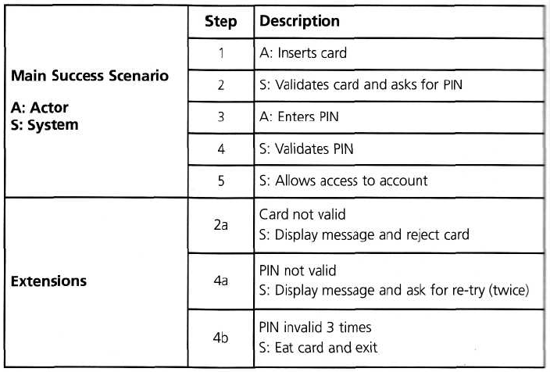
Use Case Testing
The PIN example that we used for state transition testing could also be defined in terms of use cases

Slide 4
When to Use What…
When you want to test scenarios that have… | The most effective black box testing technique is likely to be…
Output values are dictated by certain conditions depending upon values of input variables | Decision Tables
Input values being in ranges, with each range exhibiting a particular functionality | Boundary Value Analysis
Input values being divided into classes (like ranges, list of values, etc), with each class exhibiting a particular functionality | Equivalence Partitioning
 | Positive and negative testing
Workflows, process flows or language processors | Graph based testing
To ensure that requirements are tested and met properly | Requirements Based Testing
To test using the domain expertise rather than the product specification | Domain Testing
To ensure that the documentation is consistent with the product | Documentation Testing

